Slide 1
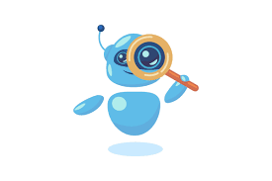
Automated Lead Generation for Chatbot Developers
01
02
03
04
05
By Jason Marchese
06

Slide 2
Concept Overview
Connect buyers and sellers
Leads (companies that need a chatbot)
Chatbot Developers
Qualify
10 Free leads!
Up-selling
Companies that can benefit from a chatbot
Identify chatbot companies that struggle finding clients
If the leads are a success. They will want to become a paying client

Slide 3
Data Pipeline
01
02
Identify target
Visit Sites
Built scapers to gather data and links from clutch and upcity
Goes to each website and extracts socials, emails, phone numbers and if they have a chatbot
03
04
Api integration
Rank leads
Checking each website for bounce rate, time on site and pages per visit.
Score the quality of leads based on gathered data

Slide 4
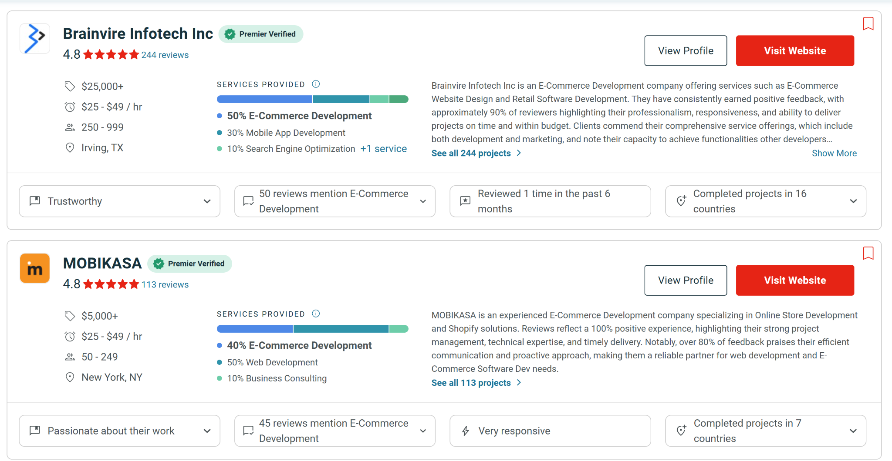
What is Clutch.co?

Slide 5
Lead Generation variables and Filtering
Clutch.co & Upcity
BigQuery Cloud dataset
Websites & API
01
02
03
04
Clutch.co/Upcity
Websites
API
Filtering
Website Link
Industry
Total Projects
Employees
Chatbot (yes/no)
Social media’s
Phone
emails
Web traffic
Bounce rate
Time on site
Pages per visit
Only no chatbot
> 0 traffic
< 100 bounce
Drop na’s

Slide 6
Lead Scoring Model
While the pipeline is running, approximately 40 out of every 1,000 leads qualify for scoring per hour, while the rest are filtered out.
01
Web Traffic
25% of score
02
Bounce Rate
20% of score
03
Visit Duration
20% of score
04
Pages Per Visit
10% of score
05
Total Projects
10% of score
06
Contact Details
15% of score

Slide 7
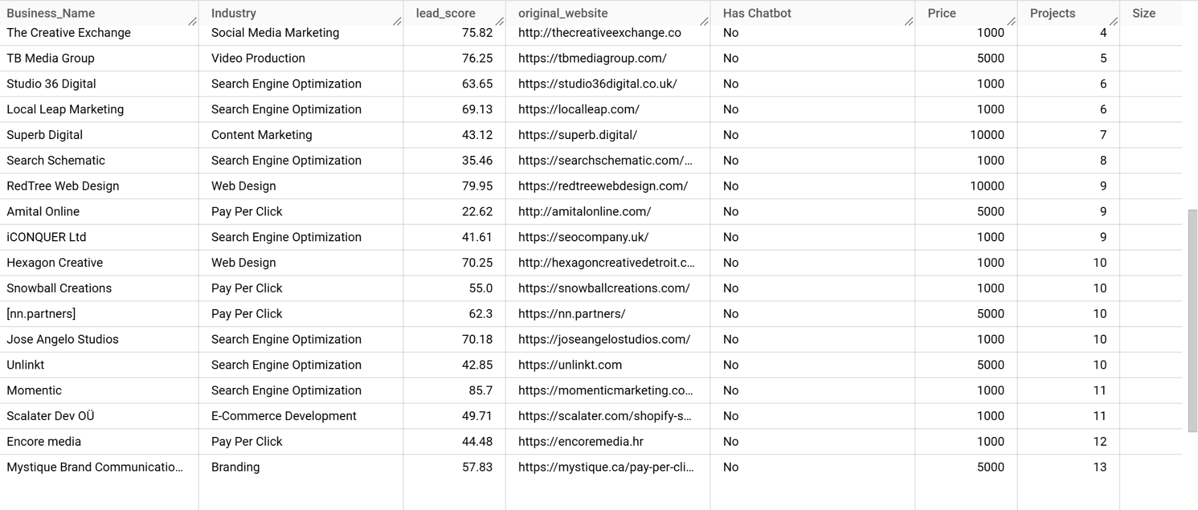
Snapshot of Dataset / Assumptions

Slide 8
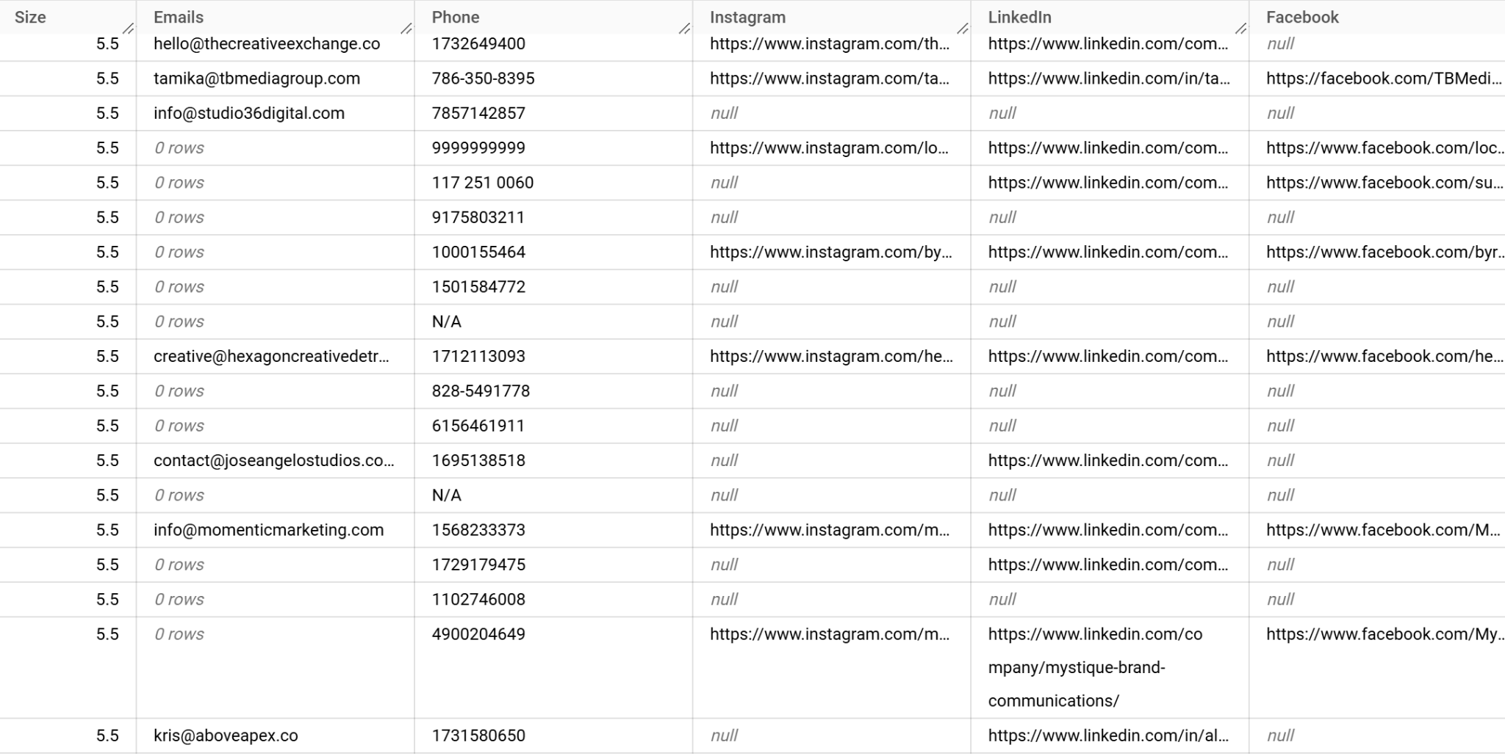
Snapshot of Dataset / Assumptions

Slide 9
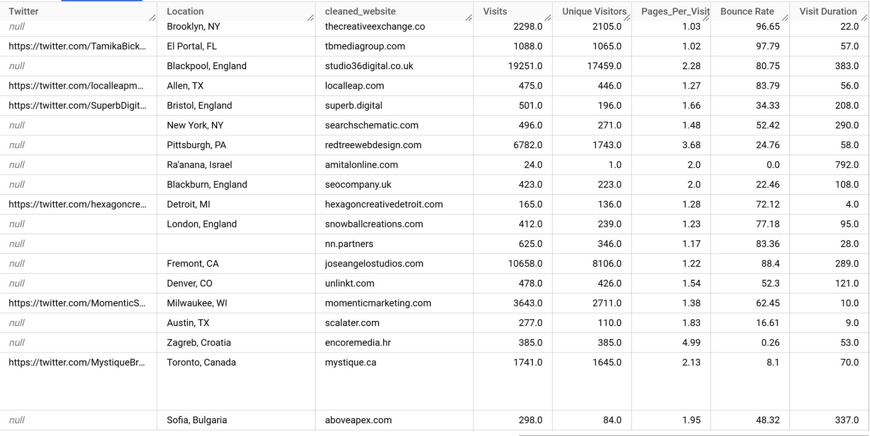
Snapshot of Dataset / Assumptions

Slide 10




Email automation and multi channel reach out
LinkedIn
Phantom buster
Gmail
YAMM

Slide 11
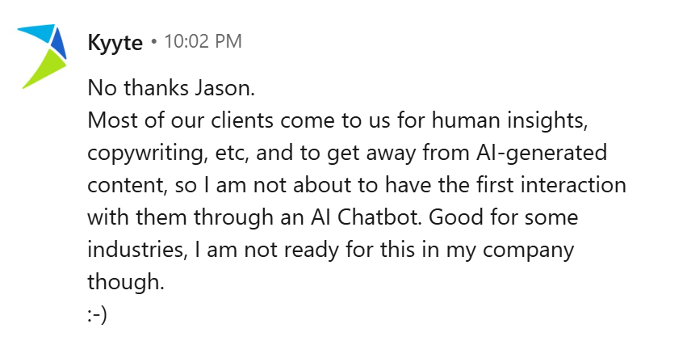
Attempt to pre-qualify leads
Realized I was searching for leads in the wrong Industry

Slide 12
Conclusion / Pivot
Connect these groups
Where I should be looking
Where I was looking
E Commerce
B2B Businesses
Chatbot devs
High traffic e-commerce stores without a chatbot.
Not the ideal target lead.
Scrape clutch.co for 5000 chatbot dev profiles.

Slide 13
Thank You!

